Slide 1
Growing the visitor economy using the outdoors
Lyndsey Swift
Head of Strategic Partnerships

Slide 2
Visitor Economy: It’s Big Business
The sector is currently worth £97bn
It provides 2m jobs
Made up of 249,000 businesses
It benefits every part of the country
Projected to be £158bn (2020)

Slide 3
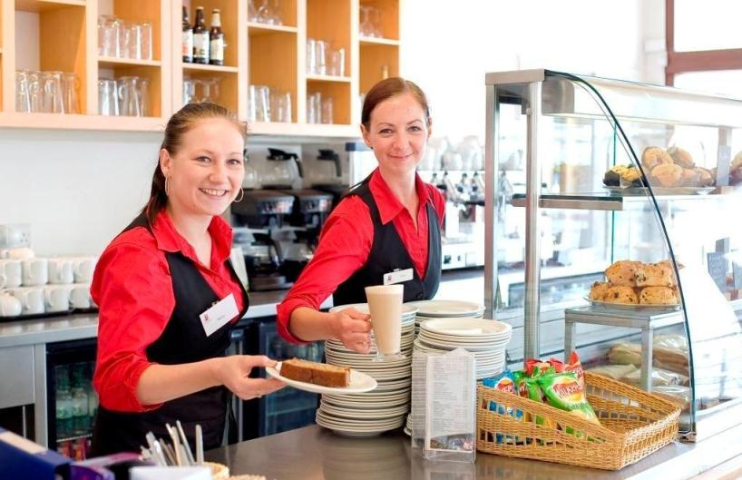
Visitor Economy?
Visitors
Leisure/ Business/ VFR
Day/ overnight
Supply chain
Core
Accommodation
Attractions
Bars/ restaurants
Related
Retail
Transport
“other” services – laundry, petrol stations, food suppliers
Notes:
Visitor spend adds local value
It helps protect and preserve our heritage
It can support localism

Slide 4
What VisitEngland does
Champion the sector and drive forward the industry’s shared Strategic Framework for Tourism
Promote England's tourism offer
Provide official intelligence on tourism and visitor economy in England
Support local areas grow their economies through tourism
Advise Government on English Tourism issues
Notes:
Our Mission = “To lead and drive forward the quality, competiveness and sustainable growth of England’s Visitor Economy”

Slide 5
Strategic Framework – 2010 - 2020
National Tourism Strategy
Stakeholders working together to achieve 5% annual growth:
225,000 jobs by 2020
139,000 in 2011 – above target
£50bn of tourism expenditure
7% growth in 2011 = £5bn – above target
VisitEngland is the custodian of this strategy:
- driving its implementation by partners
- monitoring and measuring performance
Provides the context for VisitEngland’s and local areas’ activities
Notes:
Mention series of Action Plans

Slide 6
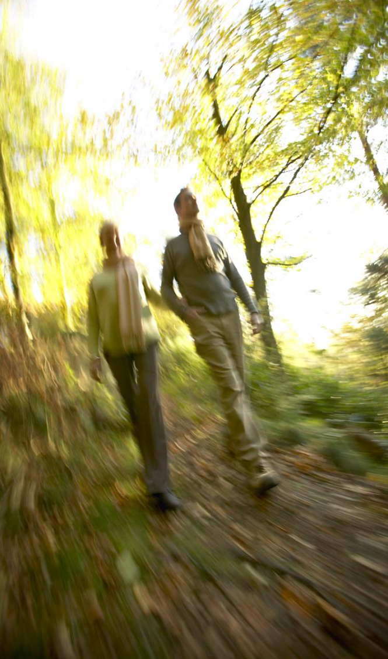
Rural Tourism
Our Countryside is one of our greatest strengths
Exploring the countryside is one of the top activities undertaken whilst on holiday in England.
There is unrealised potential and opportunities to improve the offer
Notes:
Convert Day Visits to overnight stays
Inbound trips – about 17% involve a trip to the Countryside (more can be done to promote the countryside to overseas visitors – pre and during trip)

Slide 7
In 2011, tourists spent over £76bn in England – and the majority of this was spending by GB residents
Spend on
Day trips including village destinations - £4.3bn
Day trips including “rural countryside” destinations - £5.2bn
(Day trips to any countryside destination - £8.7bn)
Domestic Overnight Trips to the countryside - £3.0bn

Slide 8
2012 domestic overnight trip volumes declined after a strong 2011...
Trips
(m)
Jan – Oct 2012
Holiday
-3%
-6%
VFR
-2%
Business
...but there was an 11% increase in GB tourism day trips in 2012
Source: GB Tourism Survey

Slide 9
Performance in 2012 has varied widely across the country
Source: GB Tourism Survey
Notes:
By location and destination type!!

Slide 10
There is also variability in performance by business type
Increased Visitor Numbers
Decreased Visitor Numbers
Source: VE Business Monitor (January 2013 Wave)

Slide 11
Spending on domestic tourism has increased despite falling volumes
Spend
(£m)
Jan – Oct 2012
Holiday
+6%
VFR
+1%
Business
+2%
Source: GB Tourism Survey

Slide 12
...but as we saw in 2011, not all businesses benefit equally from spending growth

Slide 13
1% growth in inbound travel in 2012 (spend +4%)
Source: International Passenger Survey
Notes:
Provisional 2011 International Passenger Survey results show some recovery in inbound travel. Holiday travel in particular has continued to grow in recent years, but while there was some recovery in business and VFR this year, volumes still lie well below pre-recession levels

Slide 14
There are signs of increased optimism about the economy (or at least decreased pessimism…)
Source: VisitEngland Staycation Research

Slide 15
BUT levels of concern about personal finances remain high (and may not change as quickly as people think…)
Source: VisitEngland Staycation Research

Slide 16
How Satisfied are visitors to English destinations? How does the countryside compare?
Overall
Performance
Likelihood to
Revisit
Countryside
89%
Countryside
75%
86%
excellent/
very good
90
TRI*M Index:
93
77%
definitely/
probably
70
87%
definitely/ probably
64% much/ slightly better
50
Countryside
63%
Countryside 89%
Countryside
96
Likelihood to Recommend
30
Likelihood to Recommend
Competitive
Advantage
Source: VE Brand, Communications and Satisfaction Tracker NB Base size for Peak District = 55
Source: VisitEngland Brand & Satisfaction Tracker

Slide 17
Environment and welcome / customer service score better than the norm in countryside destinations
% Describing Destination as Excellent or Very Good
Source: VisitEngland Brand & Satisfaction Tracker

Slide 18
Access issues relate to public transport rather than time / distance
% Describing Destination as Excellent or Very Good
Source: VisitEngland Brand & Satisfaction Tracker

Slide 19
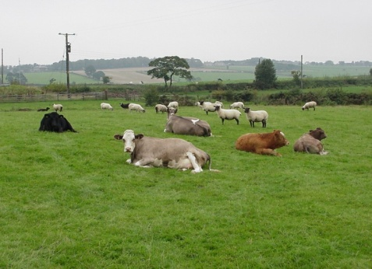
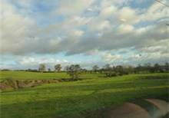
The unknown countryside.
A blurred picture despite evocative perceptions
Holidaymakers can imagine appealing countryside images (when asked to visualise)
pre-family most likely to struggle
But the various sub-categories of English countryside are not top of mind as their coastal equivalent
and it’s too easy to think about less than appealing images of industry and ‘bland’ landscapes
Don’t always have a clear image of what they can do
pre-family most likely to feel it’s boring
Across all life-stages more likely to consider the countryside (Lake District aside) for a shorter break than for coastal destinations
They’re also often unsure where to find this appealing countryside
“The countryside is just green and boring.”
(London: Pre-family)
“Norfolk, the most boring countryside I've ever seen.”
(York: Family)

Slide 20
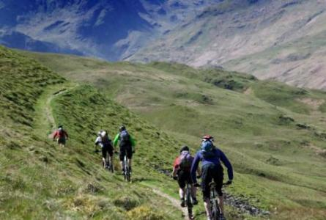
The Great Active Outdoors is possibly overly active for many of our holidaymakers.
“England is a great place for those who like a little more activity on their short break.
England has many places to go to enjoy golf or surfing and lots of other activities.
If you like wheels, enjoy cycling, mountain biking or riding a segway.
And there’s always country pubs and inns when it’s time to relax.”
While not off-putting, did not resonate as strongly as others, but found favour amongst those with older children.
Older post-family felt that this theme is aimed at a younger audience.
While many would be happy with bracing walks, some of the listed activities (e.g. surfing, cycling) are ‘not for them’.
Activities for children are important, so the thrust of this is positive, but the listed activities don't work for those with younger children.
Pre-family, surprisingly, did not feel the theme hung together beyond a list of activities.
Overall, the focus on activities means that appeal can be diluted depending on the audience, so some tailoring is required.

Slide 21
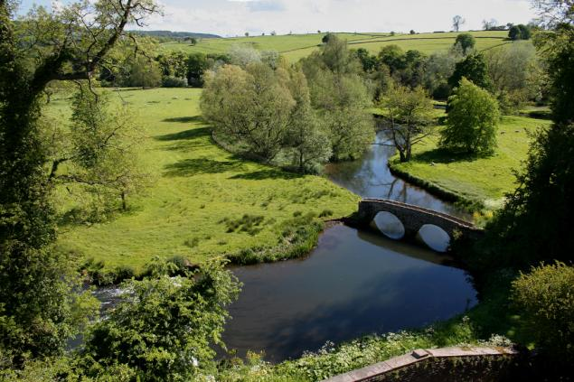
Rural escape captures one appealing facet of the countryside.
“A short break that’s on your doorstep.
Enjoy country life in the English countryside, from gentle hillsides and open meadows to national forests.
And there’s lots to do from adventure parks, gardens and zoos through to visiting a local farmers’ market in a nearby town
Strong appeal across life-stages, with particular resonance for post-family.
Peace and relaxation are key associations for this post-family; ‘escape’ is a welcome notion
Pre-family and family have some reservations:
‘adventure parks’ doesn’t have a natural fit with ‘gentle hillsides and open meadows’
for families, zoos seem a strange fit, though adventure parks and the overall focus on activity for kids is welcome
'On your doorstep' is a positive for those outside London, but Londoners anticipate overlong journeys to reach such destinations
'Rural escape' may fare better focusing on scenery rather than specific activities, though a sense of variety and things to do is important

Slide 22
We need to provide 3D inspiration and information to build consideration – and eventually, action
Where to go?
Heard of places or have vague appealing image, but not always both
Where Is it?
People's geography can be quite poor, and location and proximity steers are helpful
Need a sufficiently 3D view to be compelling
What’s there to do?
Beautiful scenery is not always enough, especially for longer trips (and if it rains…)
“After a few days you just end up doing the same thing.”
(London: Pre-family)
Source: Motivations and Barriers Research

Slide 23
Tourism is vital to the countryside
Creates employment and opportunities for business
e.g. in Yorkshire, rural areas account for 39% of all jobs in the visitor economy in the region
Provides the ability to supplement the income streams of businesses
e.g. farm diversification
Supports the economic viability of communities.
shops, pubs, restaurants, transport and postal services supported and sustained by visitors.
Contributes to the conservation and enhancement of England’s natural environment through the businesses and visitors.
Notes:
Employment figures sourced from Welcome to Yorkshire
Another good project that encourages work with communities in rural areas is “pub is the hub”
Where tourism can contribute to the conservation and enhancement of the natural environment it is important to stress that this is only with the involvement of the key stakeholders in the countryside – the collective engagement that is the next slide.

Slide 24
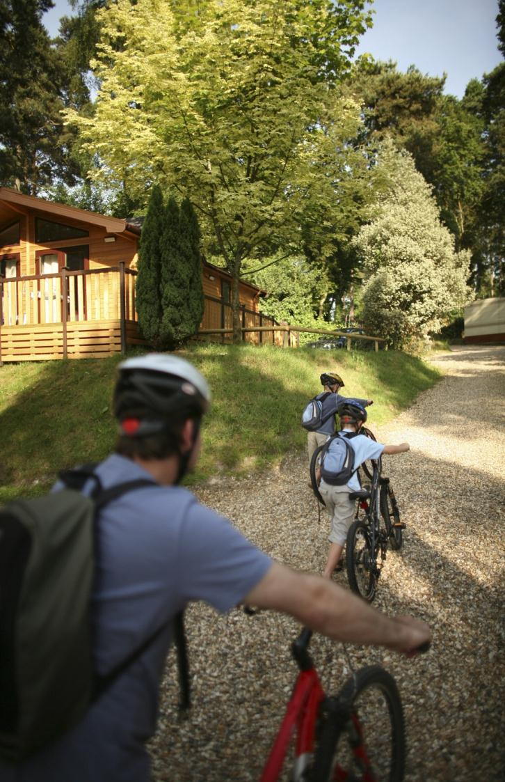
Rural Tourism Action Plan
Wise Growth - balancing the aspiration for growth with principles of sustainability
Increase the promotion of England’s rural products and experiences
Develop visitor experiences that are less weather dependent and can be enjoyed all year round
Increase the number and coverage of local solutions to manage the impacts of tourism e.g. visitor gifting
Notes:
Aim of Rural Tourism Action Plan: to maxmise the potential of the rural tourism offer to bring substantial benefits to local economies and communities – contributing to the Framework’s 5% growth target.
Diversify and modernise rural tourism products – to generate business opportunities suited to local environments and communities – and to develop a year round visitor offer.
Increase consumer awareness, understanding and enjoyment of the products and experiences available in rural areas.
Encourage rural communities and economies to benefit from the value of rural tourism – take ownership for development, management, protection and conservation of rural assets and locations.

Slide 25
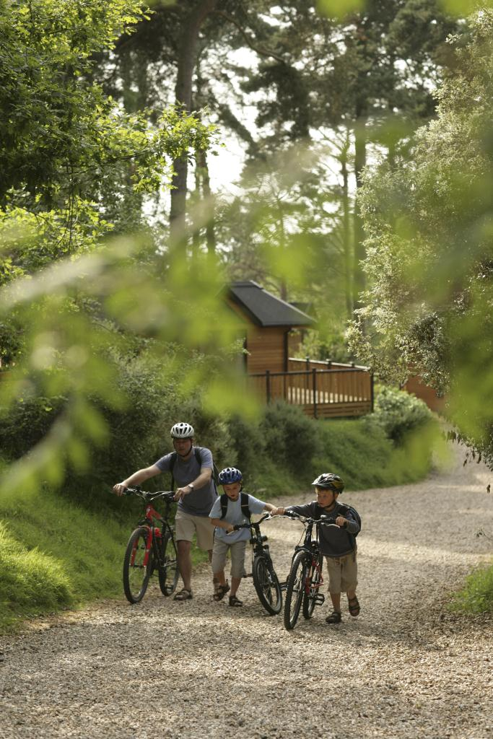
Engagement Activity
Defra
£25m Growth Review Package
AONB statement on Tourism (addressing the lack of tourism policy for these rural areas).
Partnership statement with English National Park Authority Association (ENPAA)
Notes:
ENPAA Partnership
VE and the English National Parks Authorities Association (ENPAA) developing a three year partnership (launching in Spring).
ENPAA and England’s National Park Authorities key delivers in England’s Strategic Framework e.g. Destination Management, Rural Tourism, Transport and Wise Growth.
Consumer promotion prioritised for year 1 of the partnership and linking up our research.

Slide 26
“Create more magical memories to take home and treasure….”
Notes:
Third phase of activity: Cottages4you
Time – January and March 2013
In field now!

Slide 27
“Enjoy all that England has to offer with Blacks – everything you need for Life Outdoors”
Notes:
Finalising details and not release yet so please do not tweet this!!
New relationship with Blacks – a new NON Tourism partner
More details to follow
Time – March 2013

Slide 28
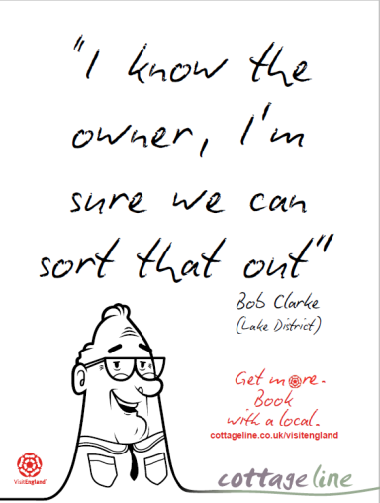
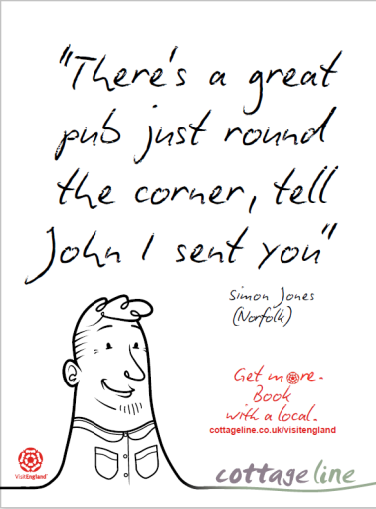
“Get more. Book with a local”
Notes:
Cottageline
Time – February 2013

Slide 29
Regional Growth Fund
3 year marketing programme with core business objective to grow tourism locally
To bring together groups of like-minded destinations and develop campaigns based around common themes creating an ‘Amazon’ effect for consumers. Unique Selling Points are the key within campaigns!
Engage with partners to provide point of purchase, product and content
21 Destinations currently involved in Rural Escapes and 12 in Active Outdoors
Work with partners to achieve 5% growth
Notes:
Amazon effect- if you like this, you may also like…
Bringing together destinations with common elements to target markets to take additional breaks. Cross-marketing.
VERY IMPORTANT to still show individual destination UNIQUE SELLING POINTS amongst that to highlight the variety in England even amongst common themes
Rural escapes – went live 25th for 3 weeks
Active outdoors live on 17th March for 2 weeks

Slide 30
Notes:
The ultimate bucket list of “things to do before you go abroad” i.e activities that are utterly unique to England, or those that compete on a global scale
www.101thingstodoinengland.co.uk
Facebook app
Incentivised with competition prizes
Six themes:
Food & Drink
Arts & Culture
Health & Fitness
History & Heritage
Wildlife & Nature
Because it’s awesome
How to get involved…….
Upload your own suggestion www.101thingstodoinengland.co.uk
Get your partners to do the same!
Tweet about it #101thingstodo
“Like” and “share” the app on Facebook
Engage your regional media – we want them to get behind their local nomination
Host the button on your own website – contact the PR team

Slide 31
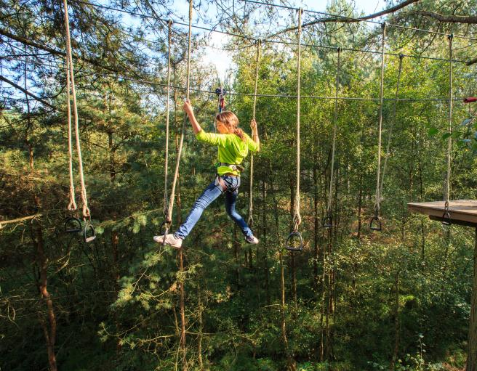
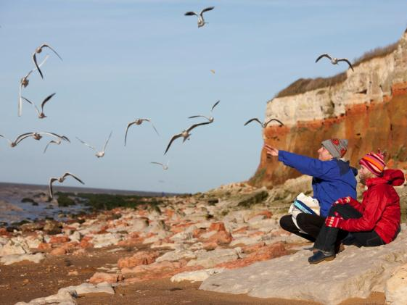
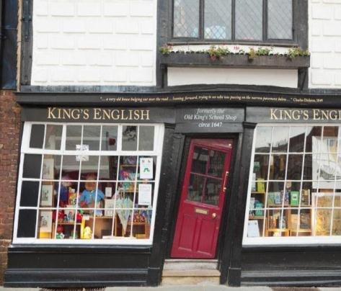
Notes:
The new online image resource for those promoting England as a holiday destination
VisitEngland Images will represent all of England’s destinations and attractions, for free, providing a free imagery resource for those helping to promote England.
VE Images brings together the best images of England into one place
The image library will be
A comprehensive tourism product
Images of England will bring together England’s destination and attraction images into a convenient, comprehensive and cohesive body, making it easier for the media and the travel industry to understand the England product and find what they are looking for quickly and efficiently.
Images to appeal to the domestic market
We need to commission images that reflect the needs and tastes of the domestic market, and the diversity England offers.
Modernise the imagery product
We need to look at new ways of interpreting destinations and attractions for the next generation, by injecting a sense of fun with friends and family and a deeper level of engagement with England.

Slide 32
Growing Locally: Partnerships

Slide 33
What does Destination Management involve?
Destination Management
Visitor Experience
Developing the destination
Selling the destination
Common Vision
Clean, tidy, safe, inviting and welcoming places
Partnership
Destination Management Plan
Accessible destinations
Understanding Performance
Product development and investment
Co-ordinated, holistic and focused marketing
Information provision
Understanding destination SWOT
Notes:
Tourism takes places in destinations
Managed well tourism in destinations can see:
Job creation
Better quality of life
Sustainable growth
Understanding the function of destination management is key.

Slide 34
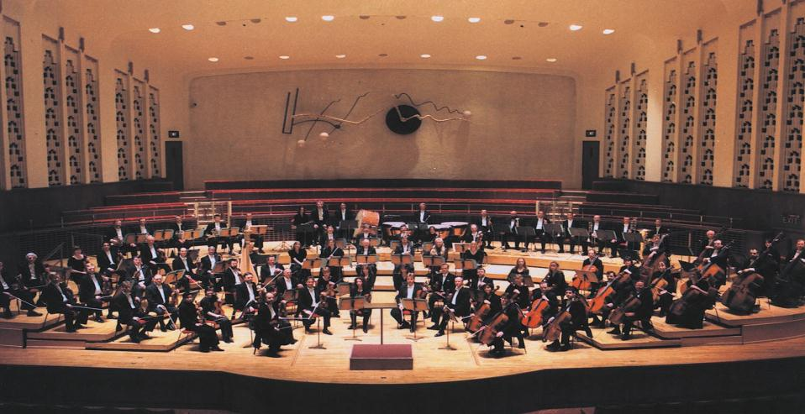
DMO – the conductor not the musician!
A voice for the local visitor economy
Successful destinations are partnerships (public/ private and 3rd sector)
Not one organisation can complete all the functions in one place (or places)
An organisation or group of organisations focused on the growth of the local visitor economy
Destination Management is far more than promotion!
Notes:
What are DMOs????
M* - re-enforce that it is management not marketing but that the M is often misunderstood/ misused.

Slide 35
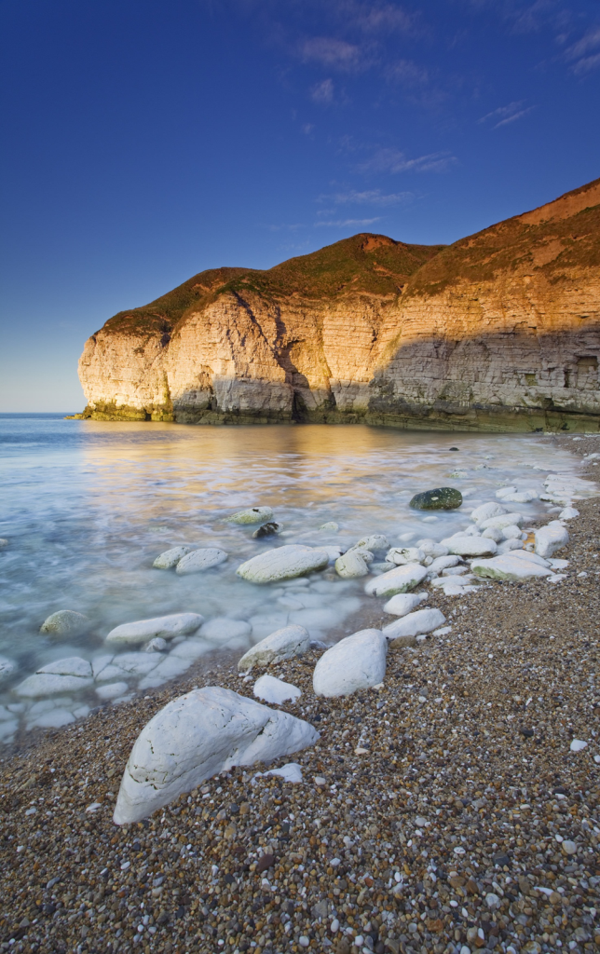
Local Partnerships: Local Success

Slide 36
Further information
Lyndsey Swift
Head of Strategic Partnerships
020 7578 1456
lyndsey.swift@visitengland.org
www.visitengland.org
Notes:
Overview

